Slide 1
Applied Machine Learning
Credit Card Approval System

Slide 2
Table of Contents
Data Acquisition​
Data Description​
Exploratory Data Analysis​
Feature Selection
Analysis
Model Selection​

Slide 3
Introduction
Commercial banks receive a lot of applications for credit cards. Many of them get rejected for many reasons, like high loan balances, low-income levels, or too many inquiries on an individual’s credit report, for example. Manually analyzing these applications is mundane, error-prone, and time-consuming (and time is money!). Fortunately, this task can be automated with machine learning, and pretty much every commercial bank does so nowadays. In this project, we will build an automatic credit card approval predictor using machine learning techniques, just like real banks do. Predicting whether a credit card application will be approved or rejected based on values of feature variables is a supervised machine learning classification task. We plan to use the logistic regression model for this problem

Slide 4
Data Source
Credit Card Approval Prediction (Cleaned Version)
Kaggle Link - https://www.kaggle.com/datasets/caesarmario/application-data

Slide 5
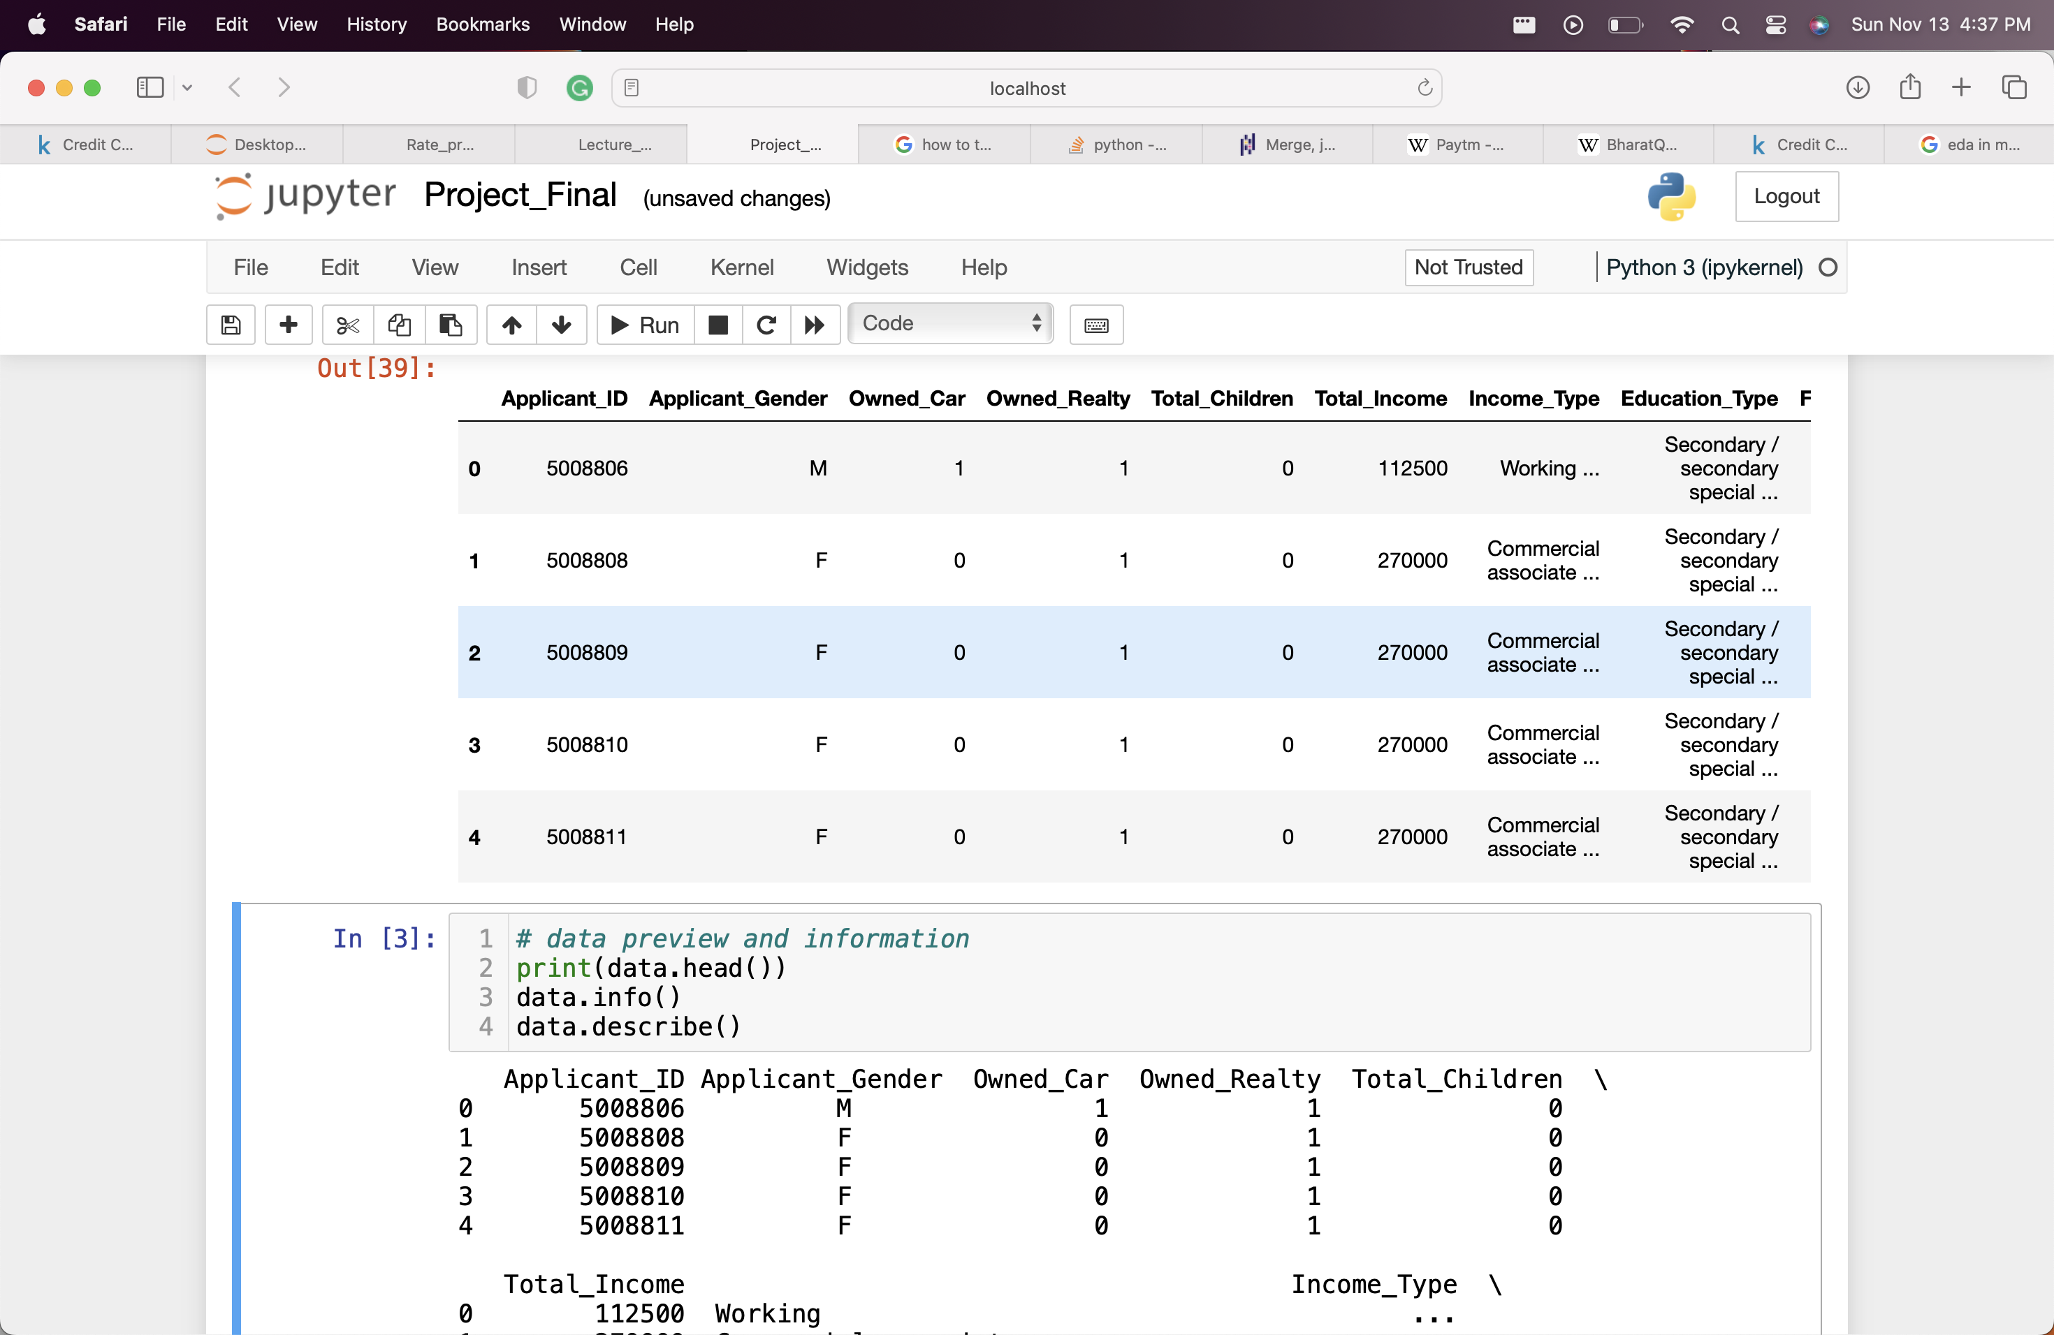
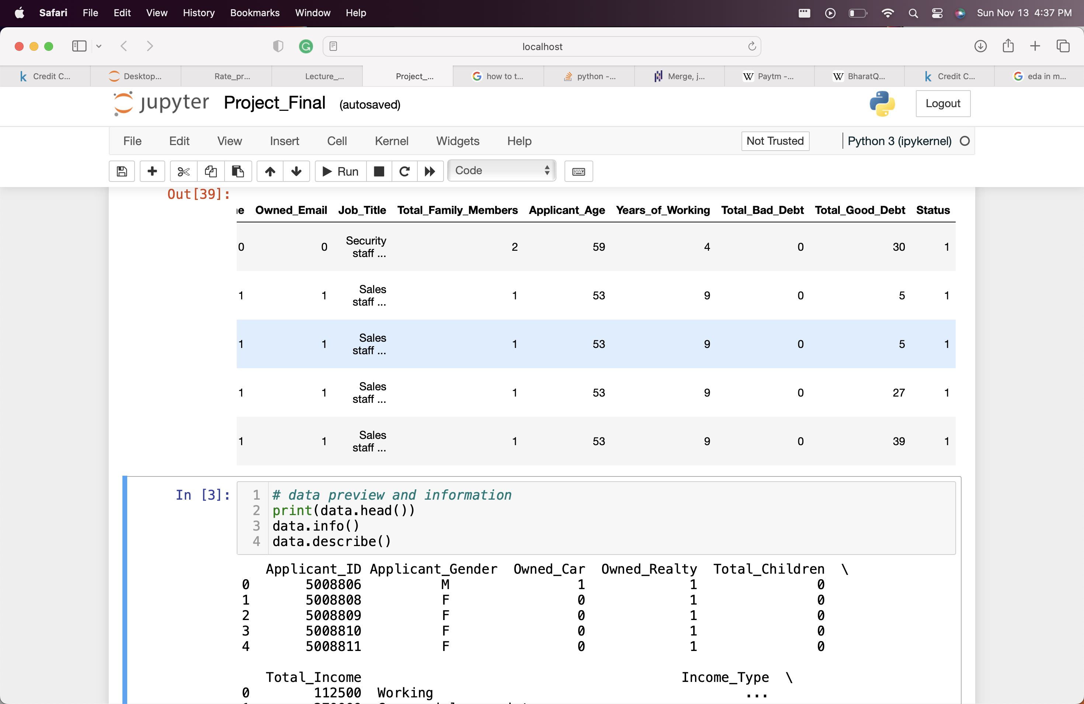
Data Description
No. Of records : ​25128
No. Of Unique Variable : ​21
Classes : 121 – Approved, 25007 - Not Approved
Total Null/Missing values: ​0
Columns Type: Numerical & Categorical​
Columns with highest missing values: ​N/A
​
Application_ID
Application_Gender
Owned_Car
Owned_Realty
Total_Income
Total_Children
Income_Type
Education_Type
Owned_Email
Job_Title
Total_Family_Members
Application Age
Years of Working
Total Bad Debt
Total Good Debt
Status

Slide 6
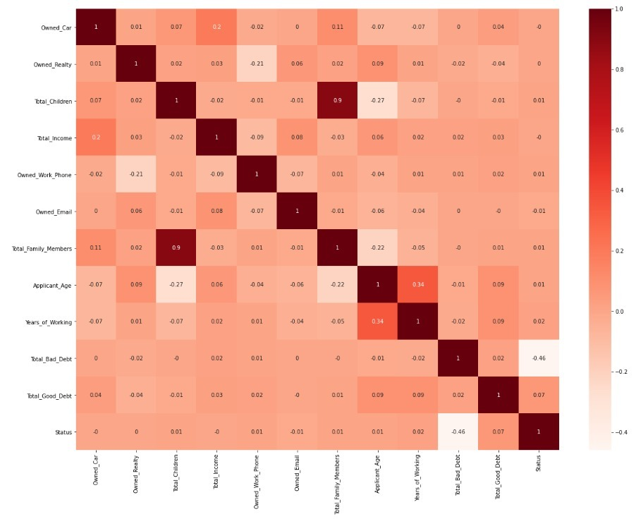
Co-relation Matrix
We don’t see very high correlation in input variables except total children and family size which is obvious
The other one is between the Applicant Age and Years of working as expected.

Slide 7
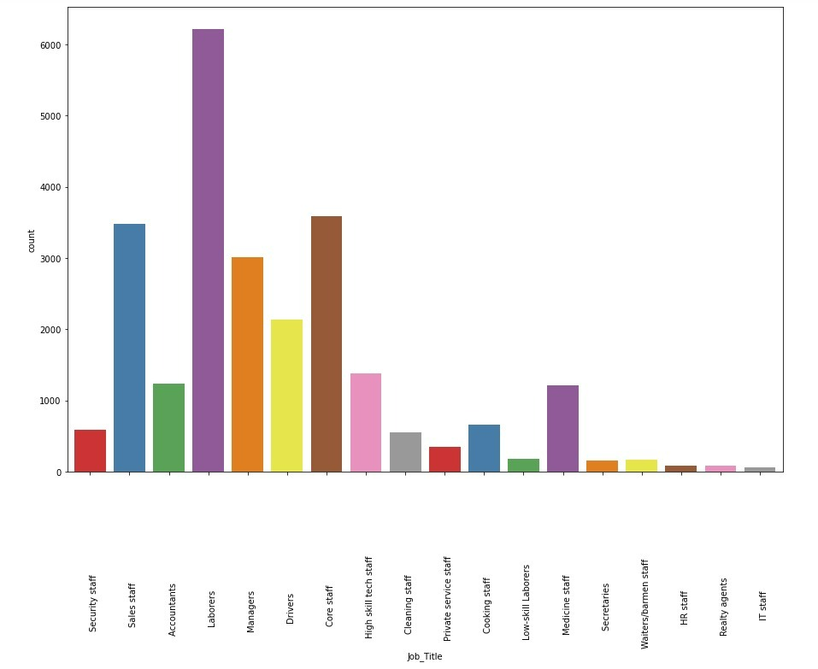
Exploratory Data Analysis
Bar graph shows that laborers was the profession that had the highest number of applicant for credit card approval.
Followed by care staff and sales staff

Slide 8
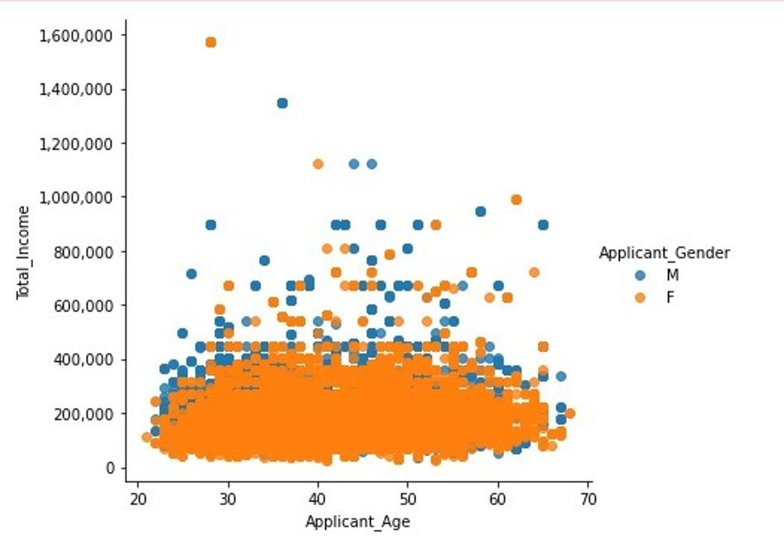
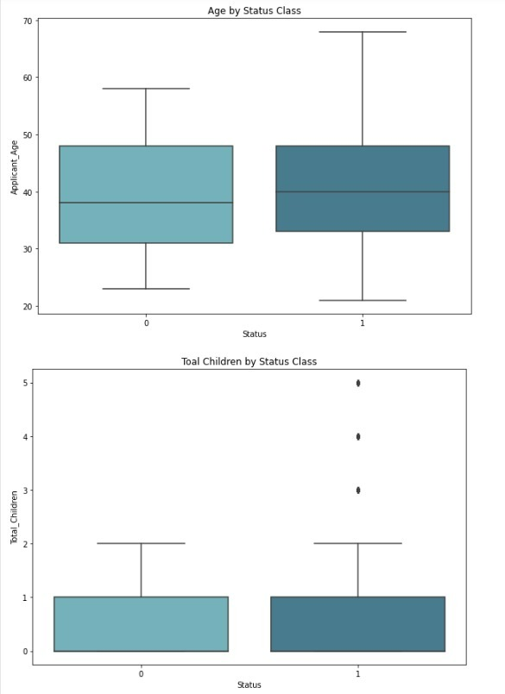
Scatter plot of gender vs total income of applicants
Female - 15627
Male - 9501
Age of applicant by Status of credit card approval
Total children of applicant by Status

Slide 9
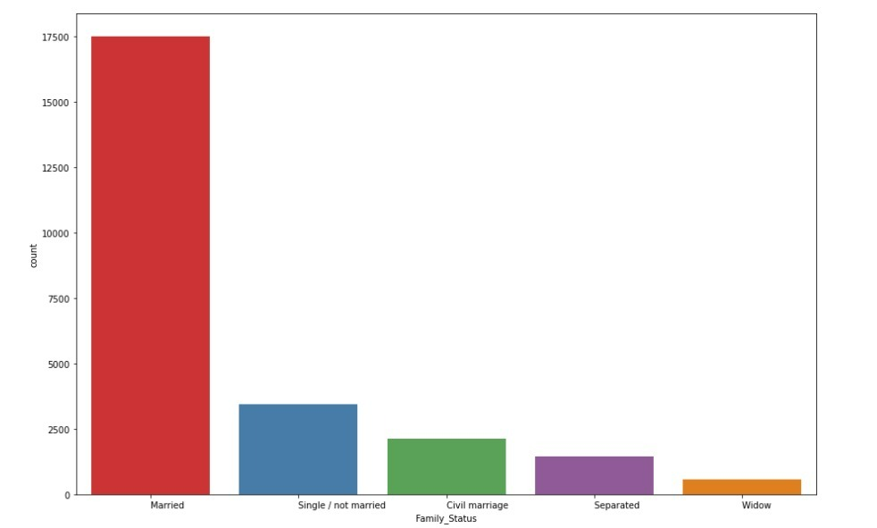
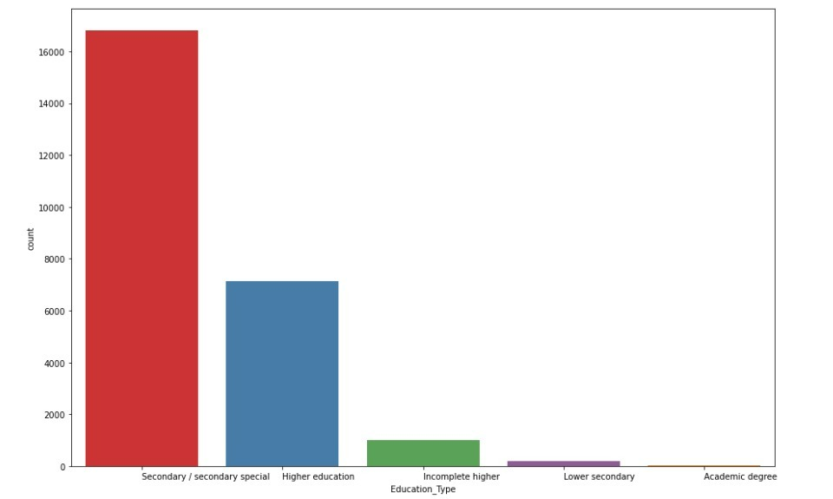
Applicants Marital Status: Majority of the applicants are married followed by those who are single
Education Qualification of Applicants:
Majority of them have completed high school.

Slide 10
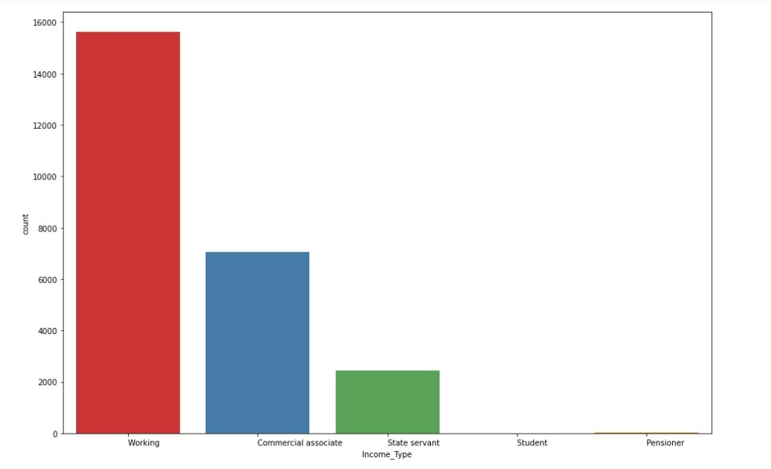
Income Source of the Applicants is shown in this bar graph: Majority of the applicants are working.
The most repeated income types are:
Working 15616
Commercial associate 7052
State servant 2437
Pensioner 13
Student 10

Slide 11
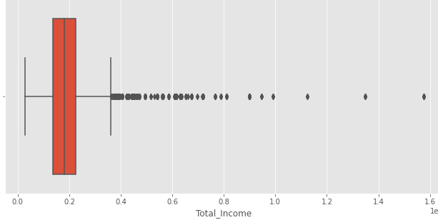
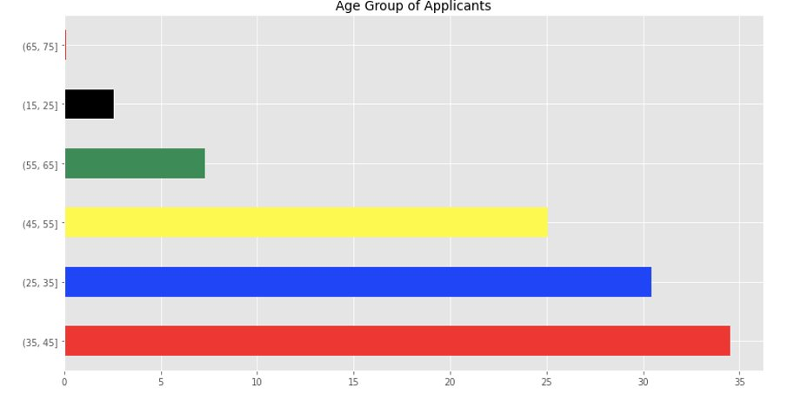
If we boxplot on total_income:
25 percentile is $135,000
50 percentile of income $180,000
75 percentile of income $225,000
99 percentile of income $585,000 beyond which incomes are outliers.
The maximum income we have is $1,575,000
When we bin the ages of applicants, we find 35-45 yrs age group has the most applicants and 65-75 yrs age group has lowest applications.

Slide 12
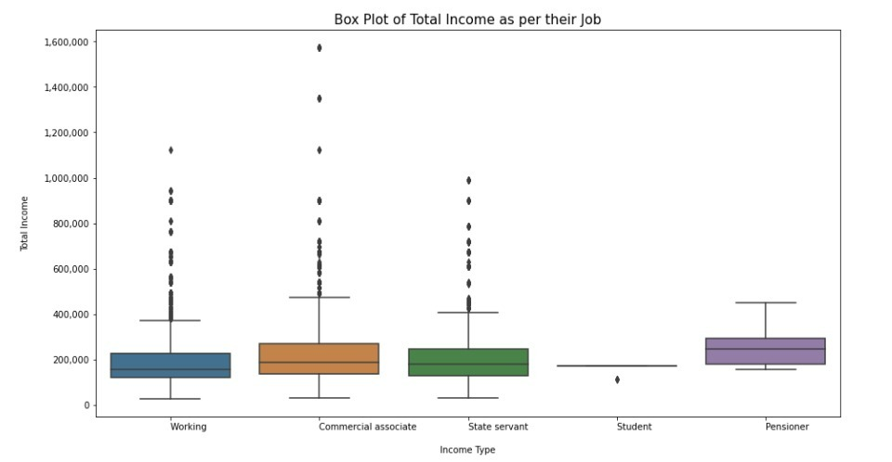
We see a lot of outliers in all the Income type and median is almost similar

Slide 13
Model Selection
In our data, we had skewed target variable, so we used SMOTE to synthetically oversample the data to remove the biasness
We ran multiple models to check and compare the performance metrics

Slide 14
Logistic Regression
Test Accuracy of the model is : 99.93 Train Accuracy of the model is : 99.87
Confusion Matrix
[[ 33 0] [ 5 7501]]
precision recall f1-score support 0 0.87 1.00 0.93 33 1 1.00 1.00 1.00 7506 accuracy 1.00 7539 macro avg 0.93 1.00 0.96 7539 weighted avg 1.00 1.00 1.00 7539

Slide 15
Decision Tree
Test Accuracy of the model is : 99.67
Train Accuracy of the model is : 99.42
Confusion Metrics
[[ 33 0] [ 5 7501]]
precision recall f1-score support 0 0.87 1.00 0.93 33 1 1.00 1.00 1.00 7506 accuracy 1.00 7539 macro avg 0.93 1.00 0.96 7539 weighted avg 1.00 1.00 1.00 7539

Slide 16
Random Forest
Test Accuracy of the model is : 99.76
Train Accuracy of the model is : 99.67
Confusion Matrix [[ 18 15] [ 3 7503]]
precision recall f1-score support 0 0.86 0.55 0.67 33 1 1.00 1.00 1.00 7506 accuracy 1.00 7539 macro avg 0.93 0.77 0.83 7539 weighted avg 1.00 1.00 1.00 7539

Slide 17
Feature Importance
('Owned_Car', 0.013673152056691458) ('Owned_Realty', 0.012177930479258378) ('Total_Children', 0.0186240392675265) ('Total_Income', 0.03039060763520587) ('Owned_Work_Phone', 0.024137272052157908) ('Owned_Phone', 0.016437782861801732) ('Owned_Email', 0.002712510383605427) ('Total_Family_Members', 0.01669971624002182) ('Applicant_Age', 0.016297054270885236) ('Years_of_Working', 0.017437791043583912) ('Total_Bad_Debt', 0.541788752935533) ('Total_Good_Debt', 0.22263200866022015) ('Applicant_Gender_F ', 0.0541142297973185) ('Applicant_Gender_M ', 0.01287715231619008)

Slide 18
XGBoost
Test Accuracy of the model is : 99.50
Train Accuracy of the model is : 99.67
precision recall f1-score support 0 0.82 1.00 0.90 33 1 1.00 1.00 1.00 7506 accuracy 1.00 7539 macro avg 0.91 1.00 0.95 7539 weighted avg 1.00 1.00 1.00 7539
Confusion Matrix [[ 33 0] [ 7 7499]]

Slide 19
SVM
Test Accuracy is : 0.51
precision recall f1-score support 0 0.00 0.52 0.01 33 1 1.00 0.51 0.67 7506 accuracy 0.51 7539 macro avg 0.50 0.51 0.34 7539 weighted avg 0.99 0.51 0.67 7539
Confusion Matrix [[ 17 16] [3676 3830]]

Slide 20
Thank You

